Slide 1





INF 558 Project Summary: Marvel and DC Comic Books Knowledge Graph
Basel Shbita, Ke Xu
11/30/18

Slide 2

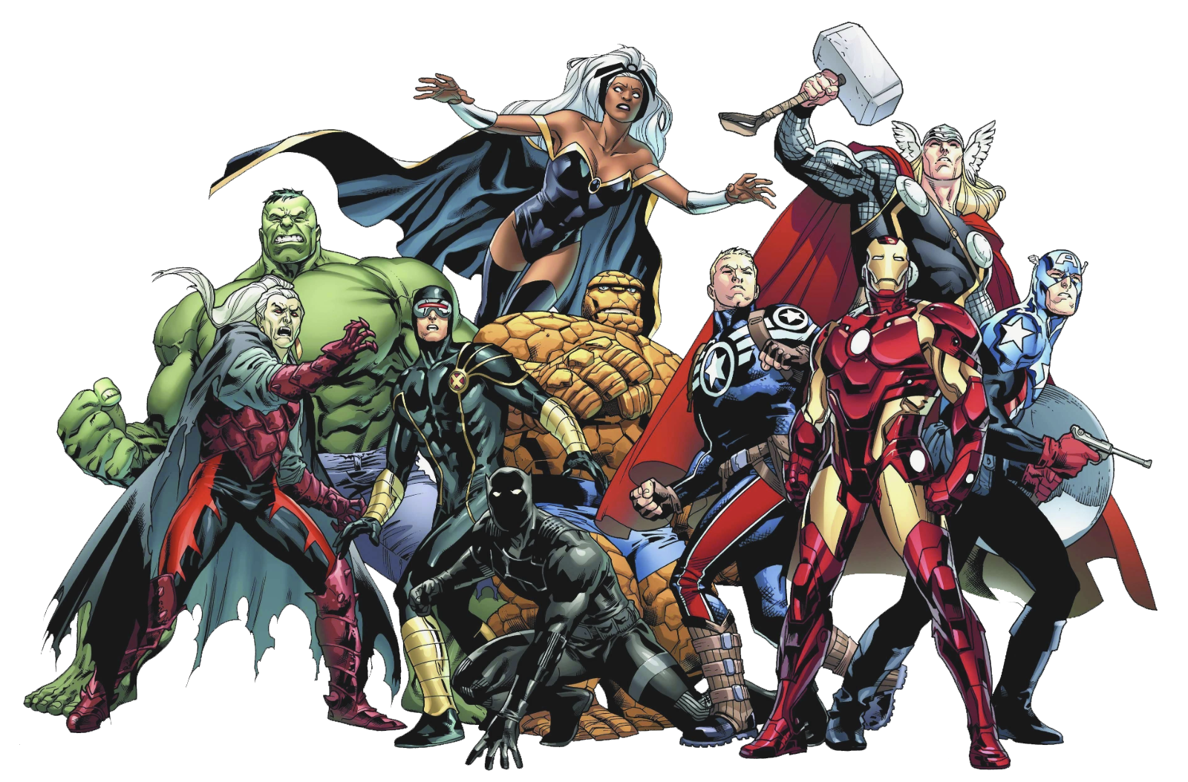

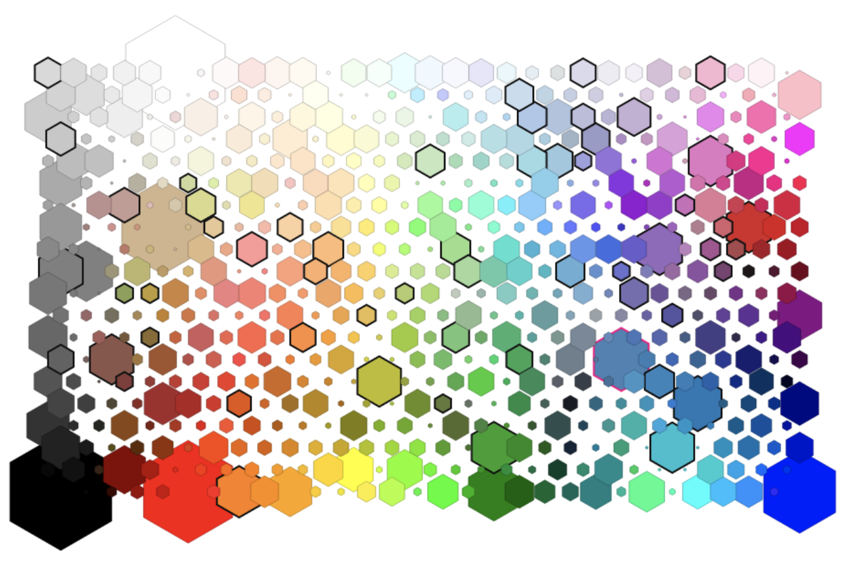
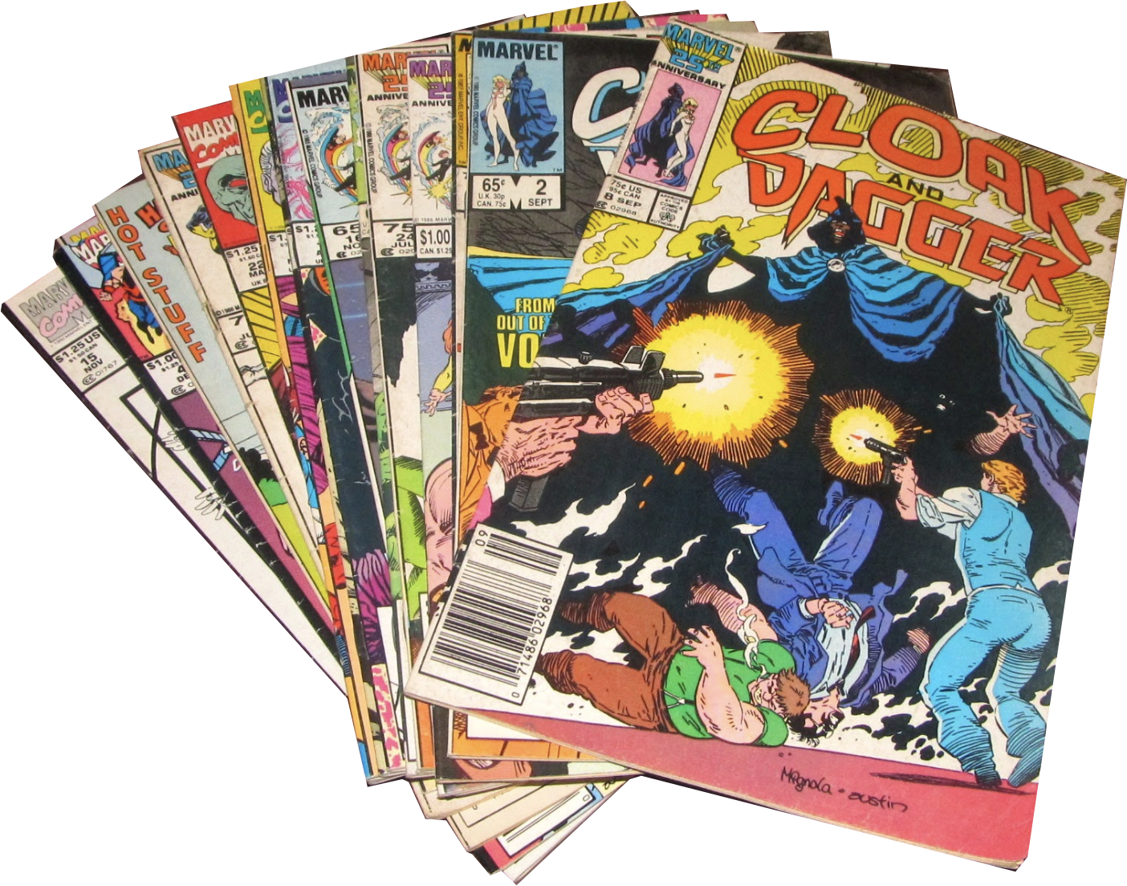

Intro (Reminder)
{
first-appearance-date
gender
publishers
birth-date
death-date
origins
powers
relationships
photos
analysis
{
{
publication-date
characters involve
cast data
reviews/score
publication-date
setting
characters involved
cast data
reviews/score
Notes:
Characters and their properties as first-appearance-date, gender, publishers, birth-date, death-date, origins (i.e. robot/cyborg/alien), powers, relationships with other characters and photos
Comic-book issues/series and their properties such as publication-date and characters appearances
Movies based on comics-books and their attributes such as publication-date, setting information, characters involved and data about the cast

Slide 3
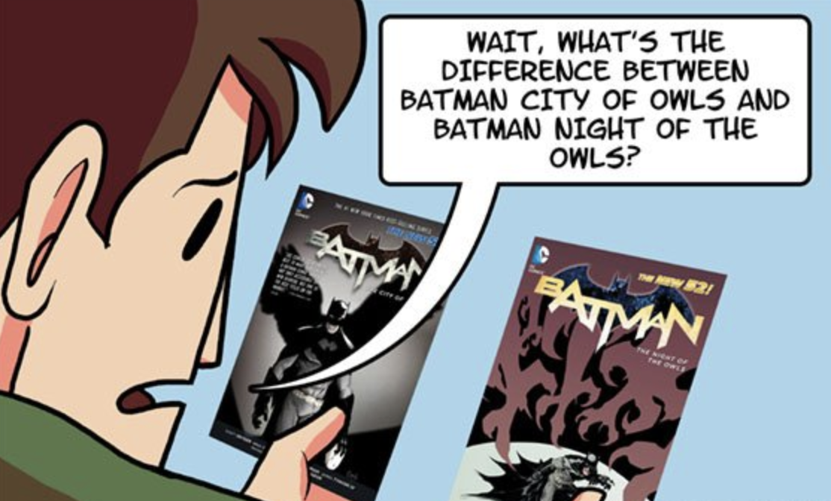
Goals (Reminder)
Expand
Explore
Discover
Their knowledge & read
issues and/or watch movies they
were not aware of!
Further in their
favorite domain
New and interesting facts!
Search
More easily!
Analyze
Data!
Characters, movies
& comic-book issues
Capture
Relations Between comic-book characters
& associated colors!
Notes:
- Discover characters/comic-book issues/movies that users may not be familiar with
- Explore and analyze data and statistics related to similarities/differences in properties of characters
- List comic-book issues and/or movies that include specific characters or characters with specific attributes (i.e. specific super-powers and origins)
- Discover familiar actors associated with the comic-book industry
- Extract relations between comic-book characters and associated colors which we will link in a weighted manner to each character

Slide 4







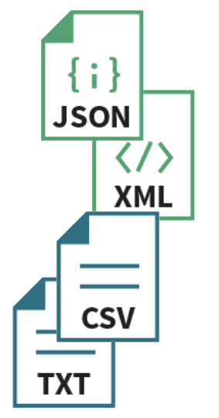
The Big Picture – Part 1!
Comicvine
Crawler
DC-wikia
Crawler
Marvel-wikia
Crawler
IMDB
Crawler
Ontology
Definition
Comicvine
Extractor
DC & Marvel wikia
Extractors
IMDB
Extractor
Ontology
Design
& Alignment
Data Cleaning & Curation
8870
2,915
29,253
103

Slide 5

Crawling Challenges
Problem
SCALE (Ms of pages)
Don’t mind me!
I’m just crawling!
Solution
Focused approach
Generate hub pages to easily reach authority pages

Slide 6
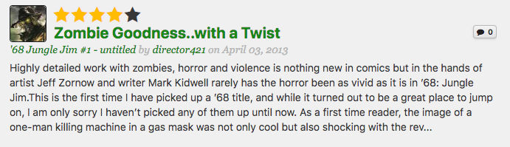
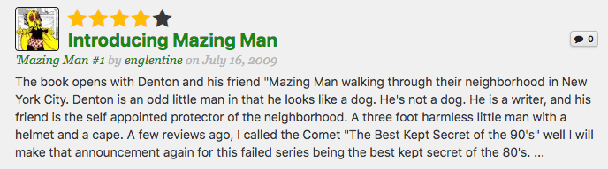
Crawling Challenges
Irrelevant Pages
Problem
I.E. Comicvine 1st crawl result:
Crawled: 68,294
Usable: 10,902
Don’t mind me!
I’m STILL crawling!
Pattern Matching
Solution
Implement strict pattern matching and re-crawl some of the data.

Slide 7

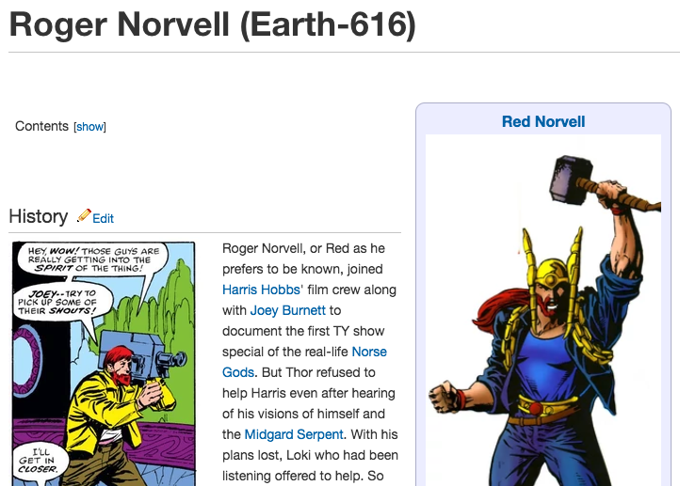
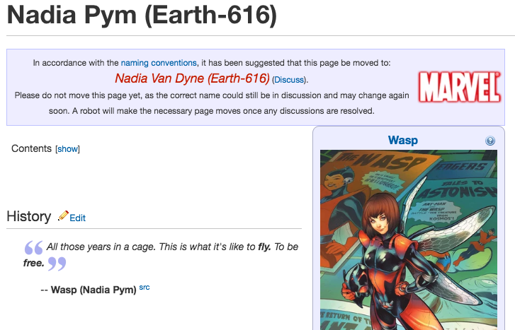
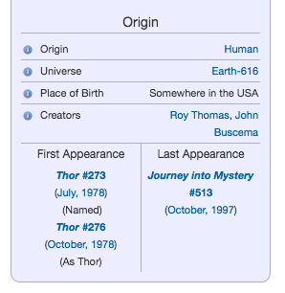
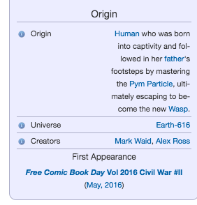
Extraction Challenges
Structure
Inconsistency
Problem
Solution
Rule-Based System
Implement rules to segment data and look for syntactic patterns, regex & structure features

Slide 8


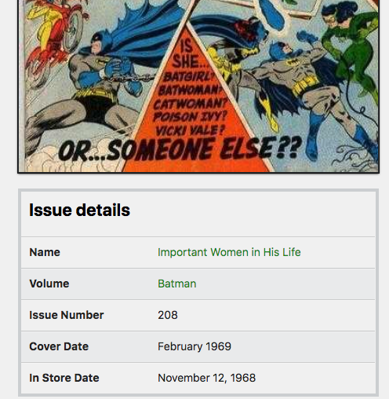
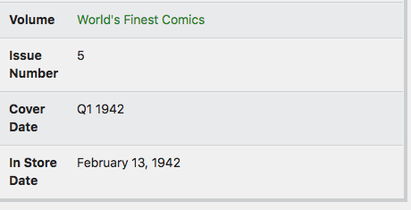
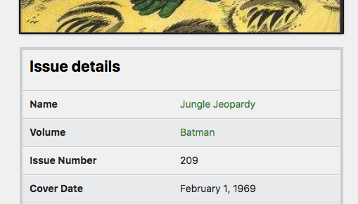
Data Cleaning Challenges
Format
Inconsistency
Problem
Solution
Classify &
Transform
Classification determines the Transformation type

Slide 9
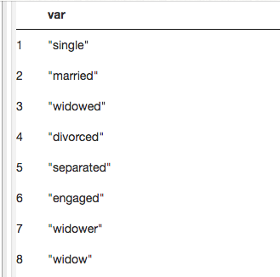
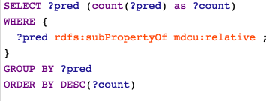
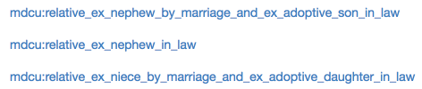
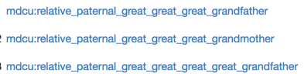
Data Cleaning Challenges
Problem
Multiple Values
Same Meaning
!!!
Solution
Clustering
Cluster the different types
Define a ‘fixed’ set
Re-classify and transform

Slide 10

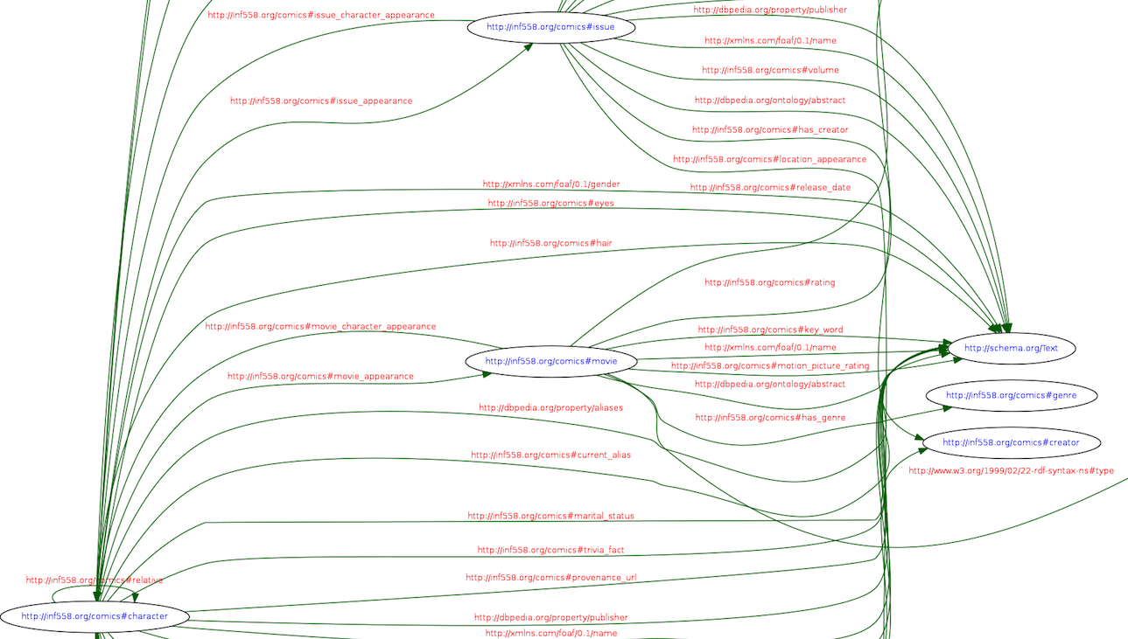
Ontology Challenges
Problem
Capture concepts
With minimal effort
Solution
Combine pre-defined ontologies with custom one
We utilized existing ontologies as schema.org, xsd, foaf and dbpedia (dbp, dbo, dbr)

Slide 11



The Big Picture – Part 2!
TTL Triples Generation
1,071,396
Image Color
Analysis
Entity
Resolution
Flask
Server
(Front End)
RDF
Deployment
(Jena)
Happy user

Slide 12
Entity Resolution Problems
Movie.character
?
Character
Issue.character
?
Issue.location
Character.birth_place
?
.place_of_operation
Character.alliance
Issue.team
?
Solution
ISI-RLTK
Use different attributes we have for each entity to perform entity resolution

Slide 13

Entity Resolution
mdcu:issue
entity
:publisher
:movie
character
appearance
mdcu:character
entity
:name
:real_name
:publisher
EXAMPLE
Issue.character
IssueCharRecord
(rltk.Record)
WikiaCharRecord
(rltk.Record)
publisher
name
name
publisher
?
name tokens
name tokens
Character
==
Jaccard
Jaro
Winkler
Similarity Match Rules
[mdcu:_morgan-stark_4005-19688_] ---96.19%--->
[mdcu:_wiki_morgan_stark__earth_616_]
[mdcu:_heather-glenn_4005-10365_] ---99.17%--->
[mdcu:_wiki_heather_glenn__earth_616_]
[mdcu:_richard-nixon_4005-13426_] ---77.50%--->
[mdcu:_wiki_richard_nixon__new_earth_]
match ∈ {True, False}, confidence ∈ [0,1]

Slide 14

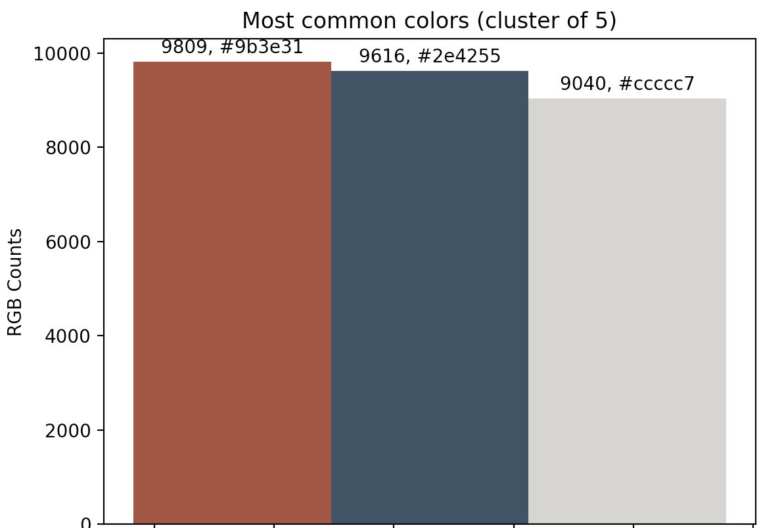

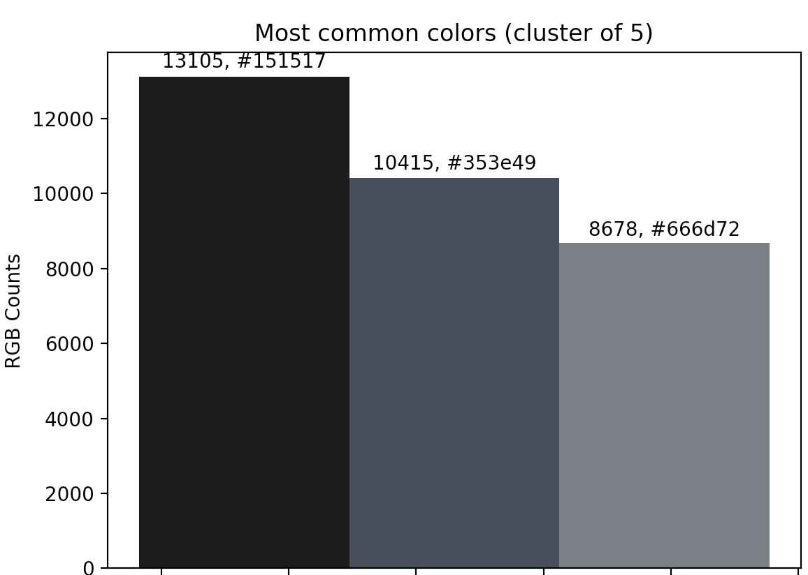


Color Analysis
Innovation
['#9b3e31', '#2e4255', '#ccccc7']
['#151517', '#353e49', '#666d72']
[ ((‘red’, (255, 0, 0)), 9809),
((‘blue', (0, 0, 255)), 9616) ]
[ (('black', (0, 0, 0)), 23520) ]
>30,000
extract dominant
colors (> 70%)
For each character:
download image (given img-url)
for cluster in range(2, 7):
plug-in to graph (rdflib)
resize
codes = scipy.cluster.vq.kmeans(..)
counts = scipy.histogram(..)
classify_by_euclidean_distance(codes, counts)

Slide 15
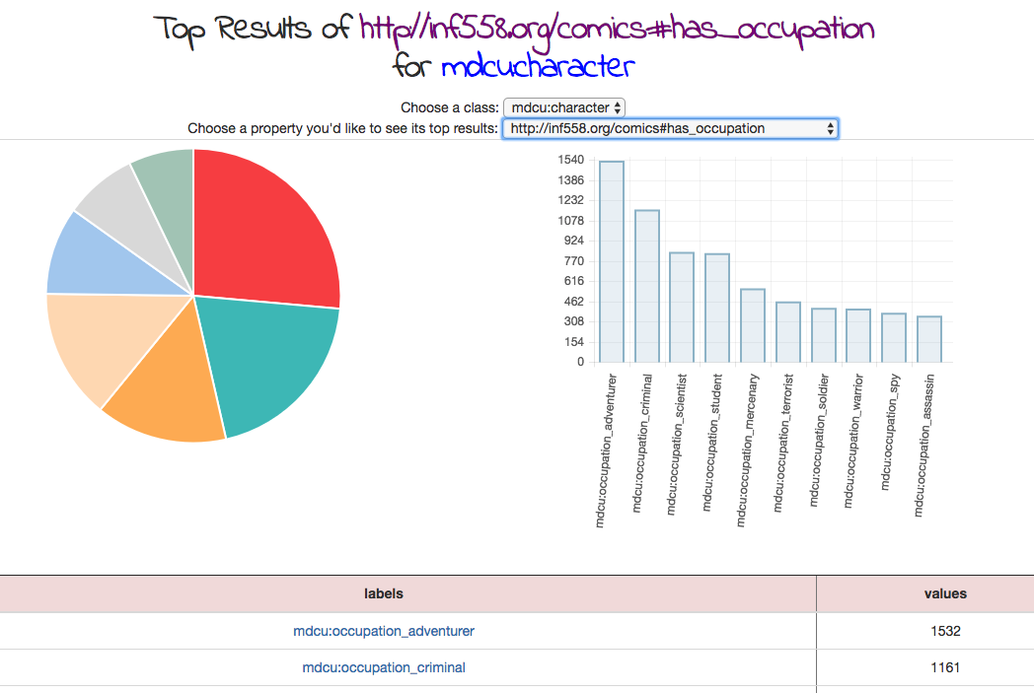


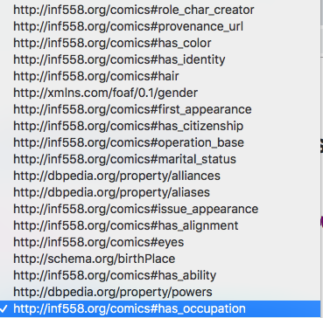
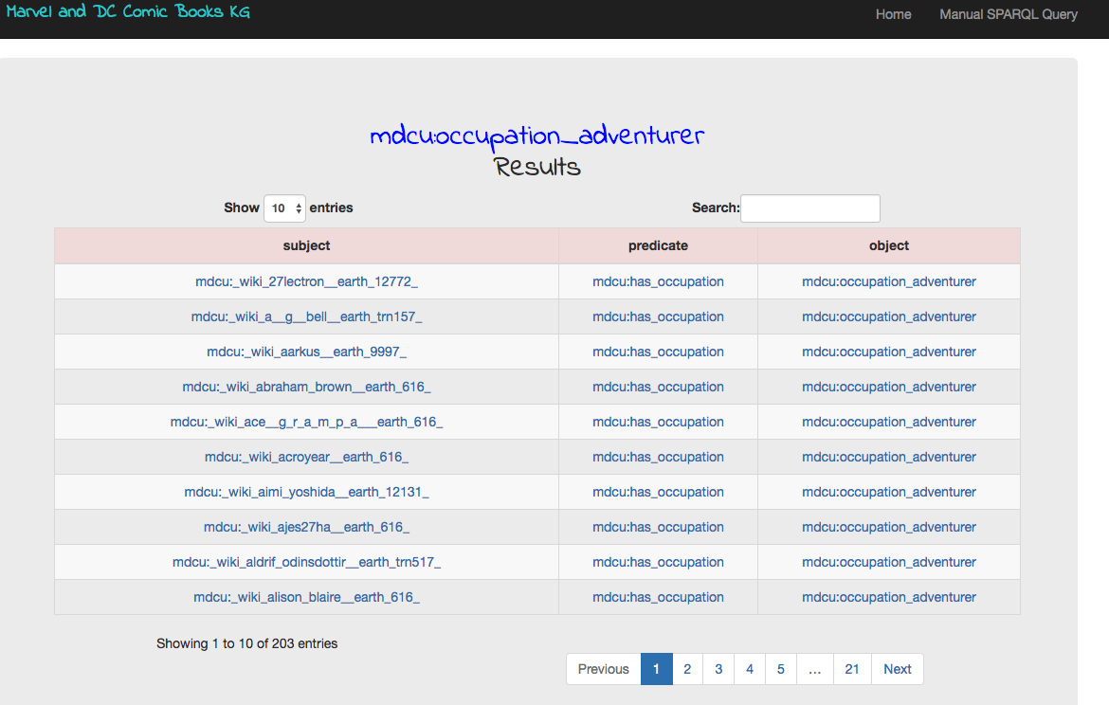
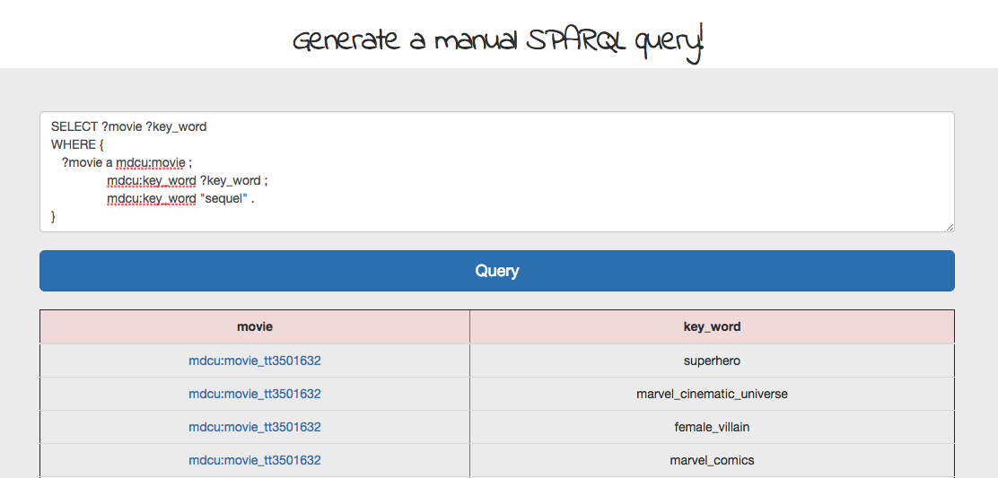
User Interface
main page
dropdown menu for class selection
+
Let’s
SPARQL!
predicates are generated automatically in BE
+
+
responsive pie and bar charts generated automatically
links to a description page
construct manual query
and get clickable results
links to a description page
perform text search within results
links to a description page
sort by s,p,o
pagination

Slide 16

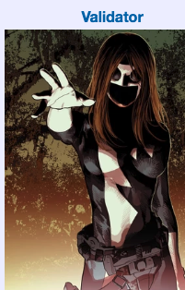
Validation
How to validate correctness of the KG in each ‘curation’ step?
generate error dump file with known patterns → cluster problems by type →
manipulate using bash scripts (grep, cut, etc..)
set of SPARQL queries → count and distinguish → triples by patterns
online RDF validation tools
+
+
+
+
visualization tools
manual labeling of entities (validation set)
Triples curation
Triples logic
Data Cleaning
Ontology correctness
Data Extraction
Data Cleaning
Ontology correctness
Entity Linking

Slide 17

Evaluation
Fixes & deploy new system
Retrospective
pitch the project proposal to friends and colleagues
Feedback!
Satisfaction? Interaction?
In the final version we presented users responded positively to all system components
Present system
Some users interacted with the system for more than 15 minutes

Slide 18

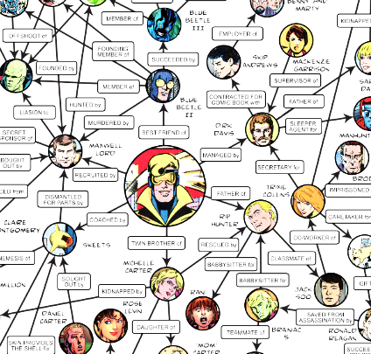
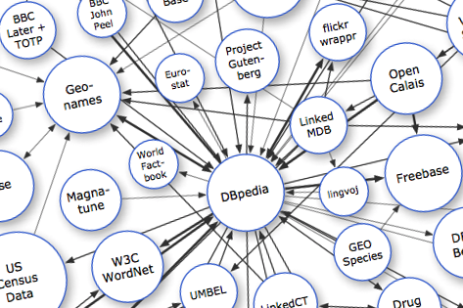
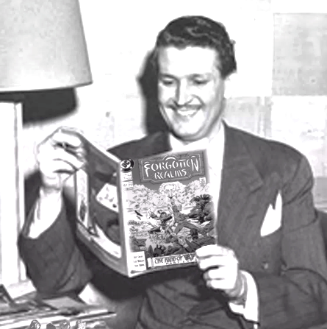

Use Cases
Predict! use ML!
Deploy to external KGs
(Linked Data)
Define axioms Run inference
good vs. bad, how is color related to that?
use comic-book scores and movie ratings!
contribute to the open world of linked data
utilize the information we have on relations between characters!
Consumer?
Navigate and walk through our graph!
Explore further!
Provider?
Explore the trends, the gaps, how can you fit in?
who is the inker of your favorite comic books issues? what else did he ink?
characters origins, popular attributes, ratings and scores

Slide 19
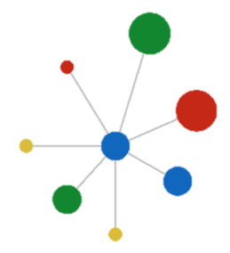

Conclusions
Working with existing ontologies can make it much easier
Carefully design a focused crawler
make use of work done by others!
don’t ‘blind’ crawl
Blocking Schemes for Record Linkage = super useful
Good ontology = Good KG
we believe that a good indicator for a well-constructed-KG is the complexity of composing a SPARQL query for any request
Can save a lot of time, even when it’s not smart

Slide 20

Conclusions
KG > RDB
KGs shine when the goal is to capture complex relationships in vast webs of information.
In the domain we chose, and to the best of our knowledge, there is no active system which gives a user an easy way to navigate between the different personas behind the comic-book industry.
Our system makes that task look easy!

